Slide 1
Observation Notes
Hello Facilitator!
Thanks for being part of this Co-Lab ☺
This guide will show the different steps of the workshop as outlined in the instruction zine each team has. It will also give you prompts to guide the discussion in your group.
On the right side of the sheet there’s space for you to take notes. Please write down your observations of the group dynamics – how the team are working together, agreements and disagreements.
Your role will be to help the participants to express their thoughts and guide the discussion to the general aim of the workshop: build a collaborative image answering the question “What is the street of your wildest dreams?”, while taking notes and photos of the process.
Thanks again and enjoy!

Slide 2
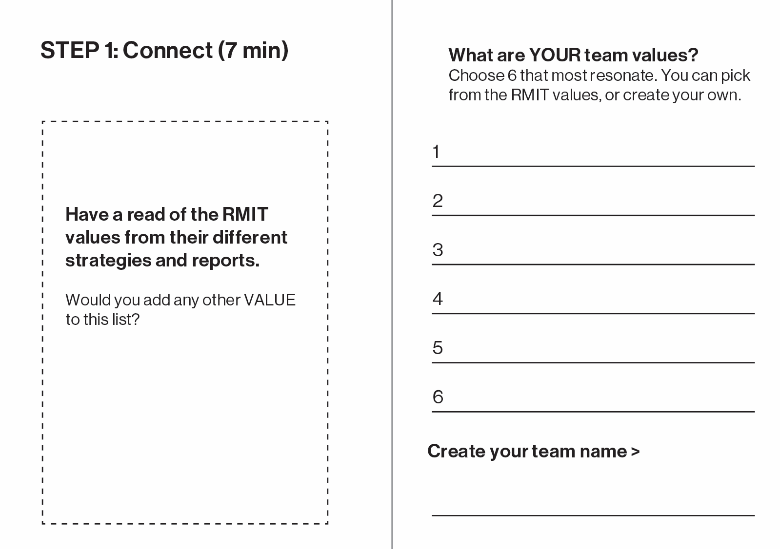
Observation Notes
Facilitation Prompts
The sheet of paper folded in the zine has a compilation of all the values mentioned in RMITs report.
You can choose whether to read the values one by one or open the discussion immediately to ”What are your team values?”
Make sure everyone in the group has a say
Encourage people to connect to their feelings, emotions, and empathy.
What is important for them in public space? What should the street make them feel?
If needed, use the observation space on the right to shortlist values
Then, assist the team in choosing the final 6
Perhaps inspired by these values, help the group choose a team name

Slide 3
Observation Notes
Facilitation Prompts
2.1
First, assist the team in writing down what they want to do in the space using verbs (e.g. play, create, collaborate, rest). These can also be more specific (watch birds, meet with friends).
Brainstorm these on the large pieces of paper on the table using markers.
2.2
To label the blobs, you can either put some tape on one and then write on it with a whiteboard marker. Or, use a post it note.
You can join blobs of the same colour together to form a mega-blob to give the activity more space. Only one label is needed in this instance.
Think of the ‘monolith’ as a collage space
IMPORTANT:
Take photos at each stage of the design. If there are iterations, make sure these are captured.

Slide 4
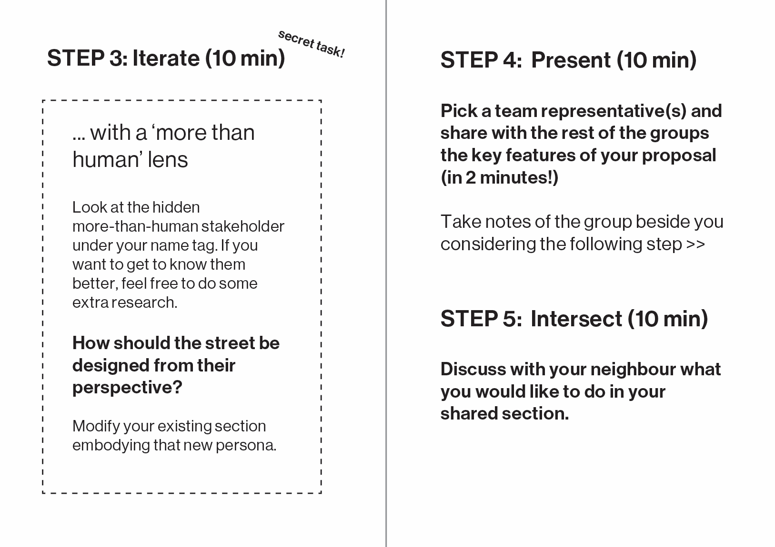
Observation Notes
Facilitation Prompts
Step 3
Make sure you have taken a photo of the section before this new iteration
Feel free to provide context about the more-than-human stakeholders and how they might interact with the space and what their needs might be
Step 4
Participants must pick one or more people to present what they have done so far
Remind them before the presentations that they need to pay particular attention to the group next to them, as they will need to work on a shared section together!
Step 5
This step is not just about filling the intermediary space, but seeing how the values and activities of the different groups can begin to intersect. What activities might be linked up? What activities don’t align, and how can they compromise?

